Slide 1

SMART GRADER
FALL 2021 CAPSTONE PROJECT | DELIVERABLE-2
GUIDED BY-PROF.HENRY WONG

Slide 2

Team Members
AKANKSHYA BISWAL
EMI HARRY
GIO ABOU JAOUDE
JONATHAN ANGAMARCA
JOSEPH DOUGAL
JOSE SALCEDO
RITHVIK SUBRAMANYA
TJ RABBANI

Slide 3

Agenda
Overview
Project Requirements
Design Architecture
Sprint Recap
Test Cases
Project Demo
GitHub Walkthrough
Retrospectives
Conclusion
Notes:
Project Description and Project Components
Technologies used in the project
Market Analysis
User personas
Milestone timeline
Retrospective: things that worked

Slide 4

Overview

Slide 5
WHAT?
A website that can generate and grade answers to math and essay type assignment questions.
HOW?
Teachers can generate questions for students with built-in math generator.
Students can access places in the required textbooks based on NLP hints.
NLP is used to generate and score text-based questions and answers.
Grades can be checked by all users.
WHY?
Lack of sufficient study time.
Lack of automated English learning platforms.
A need for a variety of questions.
Inadequacy in students' progress monitoring tools.

Slide 6

Project Requirement
This Photo by Unknown author is licensed under CC BY-NC-ND.

Slide 7
Login to the application.
Teachers/educators can generate & post questions for assignments .
Students can solve the assignments posted by their teachers and submit the assignments.
Smart Grader would grade the assignment and send the grade to the user.
All users can check their grades.

Slide 8

Project Requirements-User Stories
USER ID | USER TYPE | I WANT TO | SO THAT
USR1 | Student | Explore the website. | I can see the new and old assignments.
USR5 | Student | Create an account. | I can input my questions.
USR20 | Student | Enter my personal information safely. | I can have privacy.
USR12 | Student | Interact with the website. | I can find questions related to the same topic.
USR6 | Student | Comment on some answers. | I can help other users.

Slide 9
Project Requirements-User Stories
USER ID | USER TYPE | I WANT TO | SO THAT
USR9 | Student | Get notification of the possible vulnerabilities. | I can update my password.
USR2 | Teacher | Explore the website. | I can find old questions.
USR17 | Teacher | Sign up for the website. | I can find relevant questions for my tests.
USR12 | Teacher | Upload some reference questions. | Students can prepare for tests.
USR16 | Teacher | Upload papers. | The system can grade them for me.
USR8 | Teacher | Create a profile for different accounts. | I can group questions by topic.

Slide 10
Project Requirements-User Stories
USER ID | USER TYPE | I WANT TO | SO THAT
USR3 | Teacher | Store grades. | I can have an idea of my class performance.
USR18 | Teacher | Export grades. | I can create a report.
USR14 | Teacher | Get notification of possible vulnerabilities. | I can update my password.
USR11 | Head of Math Dept. | Explore the website. | I can see how many of my classes are using it.
USR4 | Head of Math Dept. | View results from classes on the website in my department. | I can track the student record.

Slide 11
Project Requirements-User Stories
USER ID | USER TYPE | I WANT TO | SO THAT
USR10 | Head of Math Dept. | Get notified of possible vulnerabilities. | I can update my password.
USR15 | Working Parent | Explore the website. | I can see my child's new and old assignments.
USR19 | Working Parent | See the history of grades of my child. | I can see which questions my child is struggling with.
USR13 | Working Parent | Get notified of possible vulnerabilities. | I can update my password.

Slide 12

Design Architecture

Slide 13
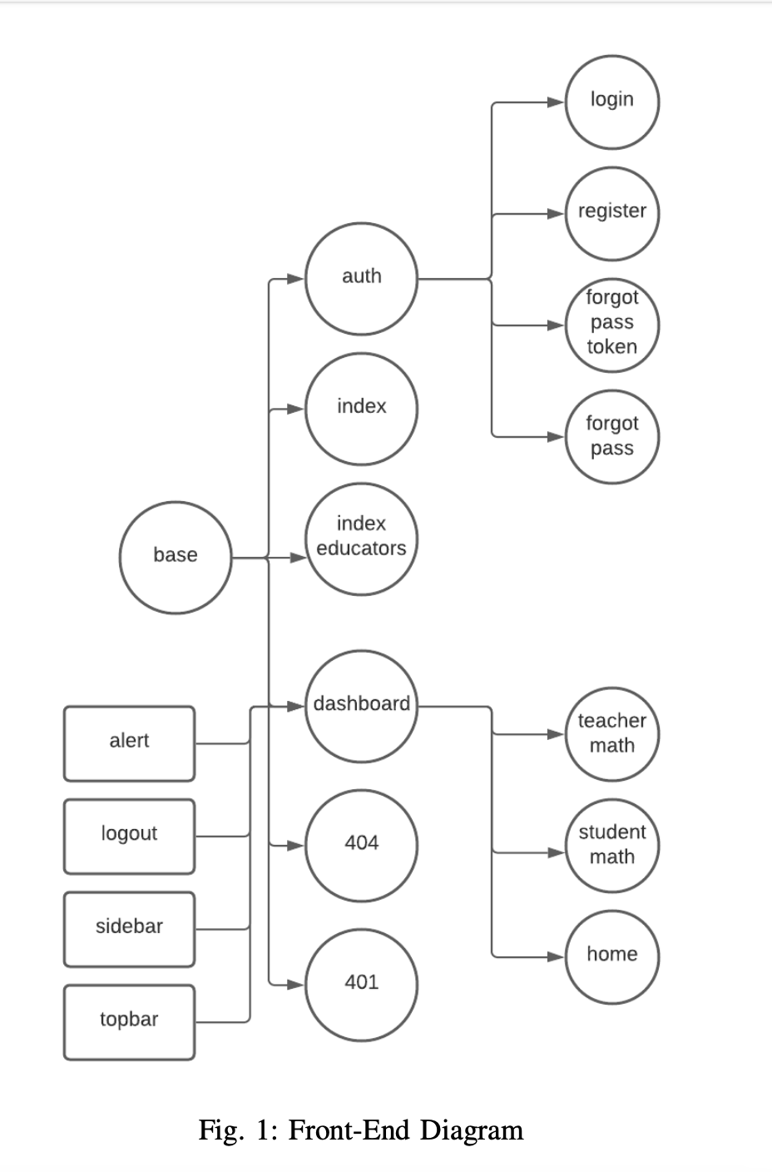

Slide 14
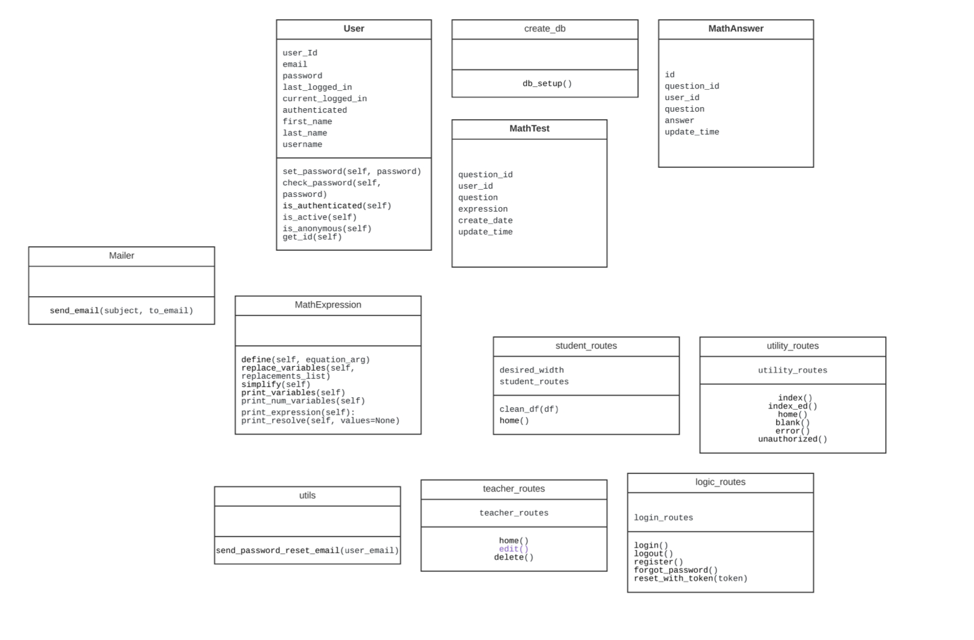
UML CLASS DIAGRAM

Slide 15
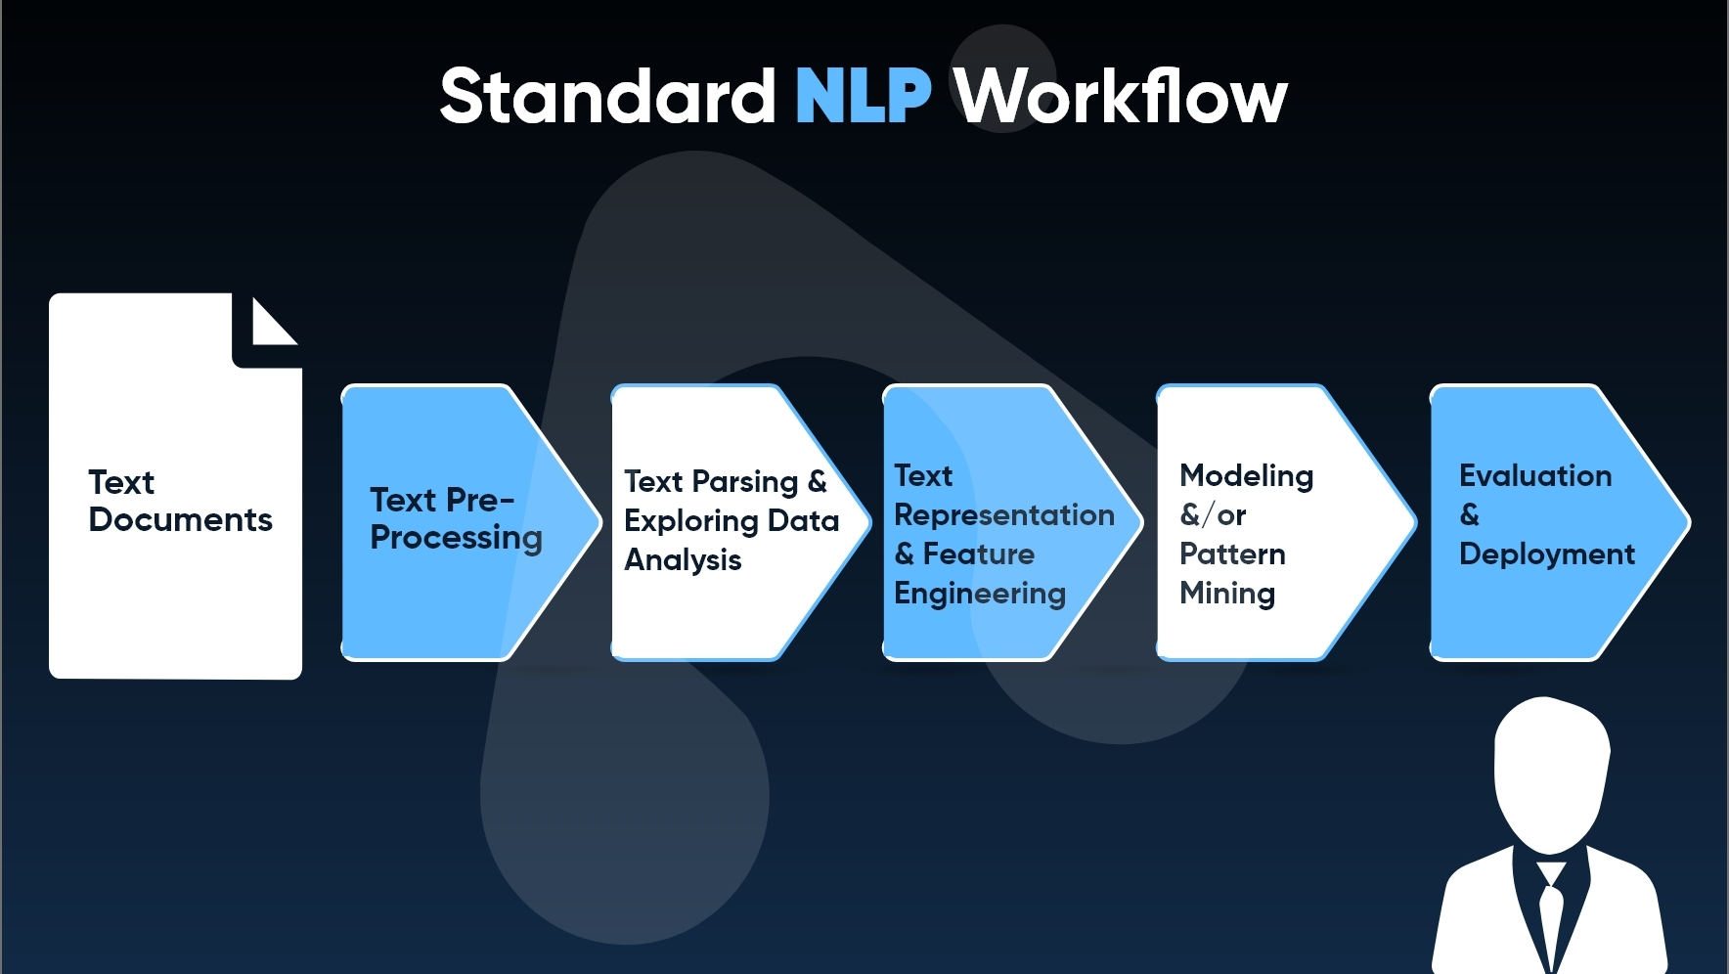

Slide 16

Sprint Recap
This Photo by Unknown author is licensed under CC BY-NC.

Slide 17
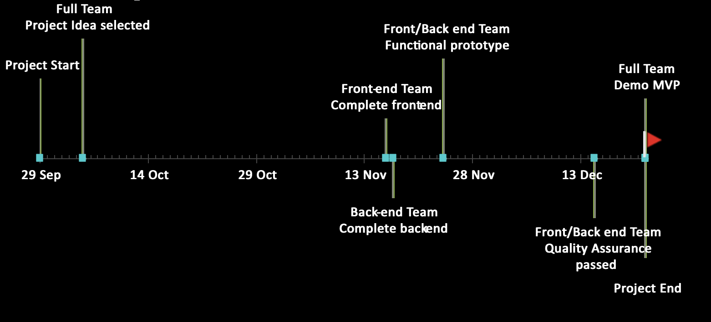
Timeline

Slide 18
SUMMARY OF THE ISSUE | ISSUE TYPE | PRIORITY | STATUS | ESTIMATED TIME
Project Survey | Task | Highest | Done | 3days
Create an estimated timeline for the project | Task | High | Done | 3days
Create Deliverable 1 presentation | Task | Medium | Done | 1week
Create a significant business application idea | Task | High | Done | 1week
Setup development tools(Github) | Task | Medium | Done | 2days
Establish team roles | Task | Medium | Done | 2hr
Establish team meetings | Task | Medium | Done | 1hr
REVIEW OF SPRINT 1(SEP8- OCT 6)

Slide 19
SUMMARY OF THE ISSUE | ISSUE TYPE | PRIORITY | STATUS | ESTIMATED TIME
Research and find the applications to implement in the project | Task | Medium | Done | 1week
Create user stories | Task | Highest | Done | 2hr
Complete Test cases | Task | High | Done | 2hr
Research on google BERT for NLP (backend) | Task | Medium | Done | 1week
Complete Acceptance criteria | Task | High | Done | 2hr
Create Mock-up web design | Task | High | Done | 5hr
Create Deliverable 2 presentation Creating Deliverable 2 presentation | Task | Medium | Done | 1week
REVIEW OF SPRINT 2(OCT 6-OCT 27)

Slide 20
SUMMARY OF THE ISSUE | ISSUE TYPE | PRIORITY | STATUS | ESTIMATED TIME
Completed the Front-End of the application | Task | Medium | Done | 1week
Complete the ML (backend) for the application | Task | Highest | Done | 1week
Review the user stories | Task | Medium | Done | 2hr
As a user I want to check if I am able to login to the Smart Grader application. | Story | Medium | Done | -
As a user I want to check if I can reset my password. | Story | Medium | Done | -
As a user I want to check if I can log out of the application. | Story | Medium | Done | -
Create Deliverable 2 presentation Write the technical paper for the project | Task | Medium | Done | 3week
REVIEW OF SPRINT 3(OCT 27-DEC 10)

Slide 21
SUMMARY OF THE ISSUE | ISSUE TYPE | PRIORITY | STATUS | ESTIMATED TIME
Integration of ML and the UI | Task | Highest | Done | 1week
Complete the ML (backend) for the application | Task | High | Done | 1week
Review the user stories | Task | Medium | Done | 2hr
As a teacher I want to check the subjects for which I can insert the questions | Story | Medium | Done | -
As a teacher, I want to insert and delete questions for the assignment. | Story | Medium | Done | -
Create Deliverable 2 presentation Creating Deliverable 4 presentation | Task | Medium | Done | 1week
REVIEW OF SPRINT 3(DEC 10-DEC 22)

Slide 22

Test cases

Slide 23
TEST CASES FOR | ID | TEST CASES | EXPECTED RESULTS | Actual Result | Pass/Fail
Homepage | 1 | Browse the Website | Different types of users should be able to access the homepage of the website. | Once the user access the link, they will be directed to Smart Grader homepage. | Pass
 | 2 | Create account on the Website | Users should be able to create accounts on the website to successfully log in to the website. | Once the users are in Smart Grader homepage, they can create their account. | Pass
 | 3 | Forgot Password | Existing users should be able to reset their password using 'forgot password' option on the homepage of the website. | Users can reset their password once they reach the homepage of Smart Grader using 'forgot password' option. | Pass
Test Cases for Homepage

Slide 24
TEST CASES FOR | ID | TEST CASES | EXPECTED RESULTS | Actual Result | Pass/Fail
Homepage | 1 | Generate questions for math. | Teachers should be able to input math questions for the assignment. | After a teacher/educator login to smart Grader they will be able to input math questions using "Insert question," button. | Pass
 | 2 | Delete questions | Teachers should be able to input math questions for the assignment. | After teacher/educator login to smart Grader they will be able to delete any questions using 'delete question' button. | Pass
 | 3 | Locate the upload file button | Teachers should locate the upload file button to upload the textbook pdf or notes to upload. | This feature will be available by next semester. | Fail
 | 4 | Submit the questions | Teachers should find the submit button to finally upload the file | A Teacher/educator should be able to update the questions using 'Update' button. | Pass
Test Cases for Homepage

Slide 25
TEST CASES FOR | ID | TEST CASES | EXPECTED RESULTS | Actual Result | Pass/Fail
Homepage | 5 | Load Test | Students should be able to find the 'load test' button on the top right-hand side of the page.
 | 6 | Update | Students should be able to update their answers.
 | 7 | Take me to the text | Students should locate the 'take me to the text' button near the question, which will take them to the text where they can find the answers.
Test Cases for Homepage

Slide 26
TEST CASES FOR | ID | TEST CASES | EXPECTED RESULTS | Actual Result | Pass/Fail
User Input Page | 1 | Subject | Every user would be able to locate a button which will display all the subjects for which they can get/create assignments. | After the user login to the application every user would be able to locate 'subject' dropdown on the left-hand side of their page. | Pass
 | 2 | Logout | Every user should be able to log out of the application. | Every user would be able to find the logout option in the top right-hand side of the page . | Pass
Test Cases for User Input Page

Slide 27
TEST CASES FOR | ID | TEST CASES | EXPECTED RESULTS | Actual Result | Pass/Fail
Result Page | 1 | Generate Report | Users should be able to generate the grade report of students. | Every user should be able to locate the 'generate report' option on the top right-hand side of the page to generate the report of any student. | Pass
Test Cases for Result Page

Slide 28

Project Demo
This Photo by Unknown author is licensed under CC BY-SA-NC.

Slide 29
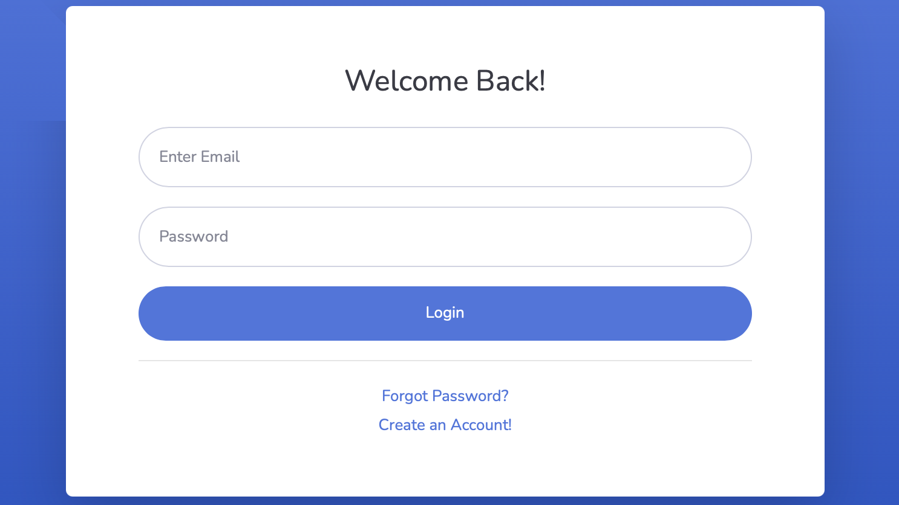

Slide 30
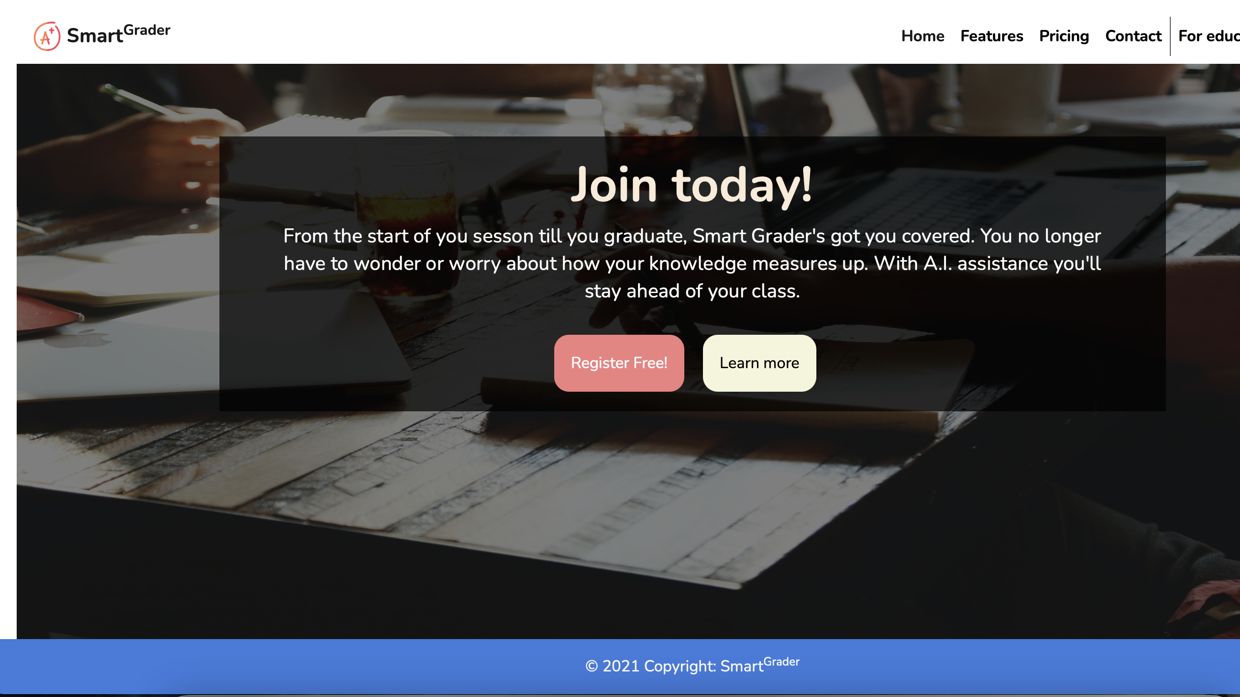

Slide 31
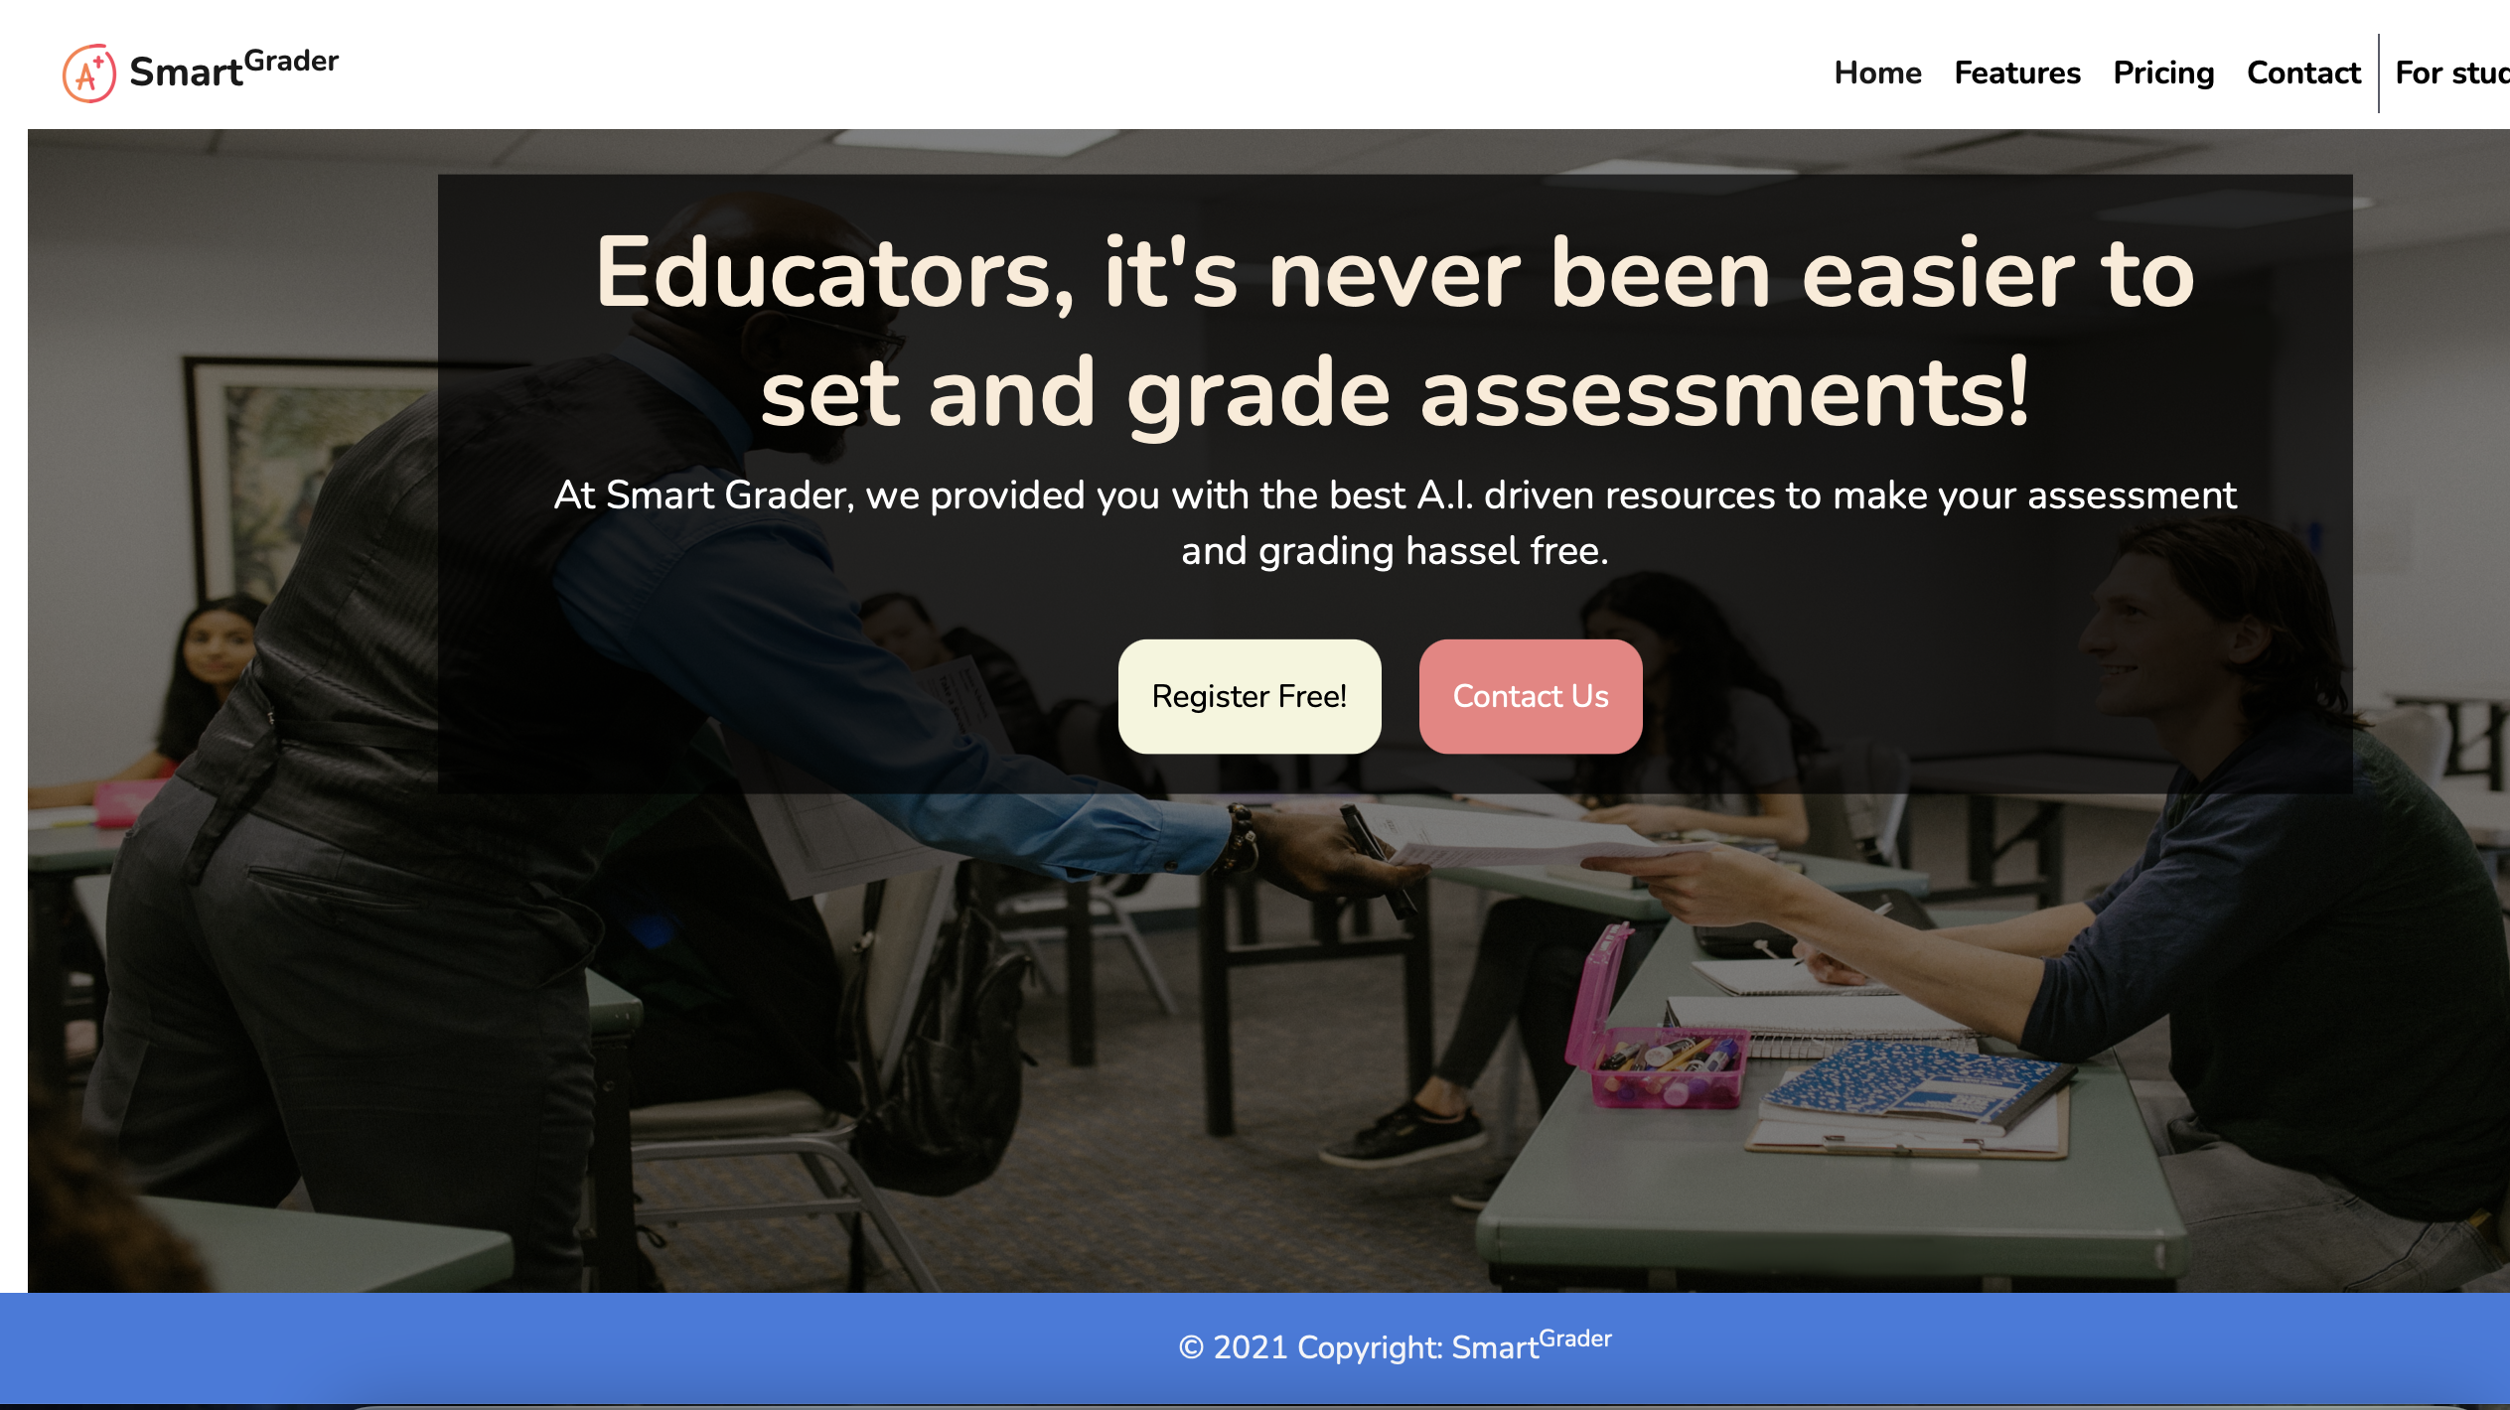

Slide 32

GitHub Walkthrough

Slide 33

Retrospective
What went well:
Scheduled time for team meeting with Zoom call.
GitHub was updated for the team.
One drive was updated with required documents.
Wiki Page for the team has been created and updated on time.
What went wrong:
Sprints weren't documented on time.
Delay in teams' response time.
Understanding what was expected of the project.
What's next:
Unified color theme for the UI.
NLP aspect built.
Improve grading system.

Slide 34

Conclusion

Slide 35
APPLICATION RECAP:-
Easier and faster to upload and grade assignments for students.
Guide you to the parts of textbooks/class texts that corresponds to a question.
Alert students and teachers to homework posted and submitted.
Grades will be visible to all users.
FUTURE SCOPE:-
Implementation of Smart Grader on essay-based questions.
May include a paywall for some features.

Slide 36


